Slide 1
End-to-End Real-Time Space Weather & Solar Storm Data Pipeline
SUBJECT : BIG DATA & DISTRIBUTED PROCESS (MCSCIN5A1825)
PROFESSOR: PROF. ZHANG YIRU, PROF. LI YUE
SUBMITTED BY: MODI GURPREETKAUR JAYKUMAR

Slide 2
PROJECT OVERVIEW
This project implements an end-to-end, distributed big data pipeline for real-time space weather monitoring using live data from the NOAA Space Weather Prediction Center (SWPC). Variations in solar wind conditions can impact satellite communications, navigation systems, and power grids.
The objective of this project is to design and deploy a scalable, fault-tolerant streaming analytics system that ingests, processes, stores, and visualizes space weather data in near real time.
The solution integrates Apache Kafka for ingestion, Apache Spark for distributed processing, Hadoop HDFS for storage, InfluxDB for time-series analytics, and Grafana for visualization. All components are deployed and validated on a multi-node distributed cluster.

Slide 3
DATA SOURCE
The system uses public real-time space weather data from NOAA SWPC.
The data includes solar wind speed, proton density, plasma temperature, and magnetic field components (Bx, By, Bz, Bt).
The data is received in JSON format and updates frequently.
Sample Data:
{
"timestamp": "2026-01-17 20:14:00.000",
"speed": "685.2",
"density": "0.05",
"temperature": "236665",
"bx": "-6.46",
"by": "3.49",
"bz": "-1.92",
"bt": "7.59"
}

Slide 4
PROBLEM STATEMENT AND OBJECTIVES
Space weather data is generated continuously and changes rapidly. Raw scientific measurements are difficult to interpret and are not suitable for direct monitoring using traditional batch-only systems. There is a need for a system that can ingest live data, process it at scale, store it reliably, and present meaningful insights in real time.
This project addresses the problem by building a distributed streaming pipeline that:
Ingests live space weather data
Processes and cleans data using Spark
Stores data in HDFS using layered storage
Provides real-time visualization through dashboards

Slide 5
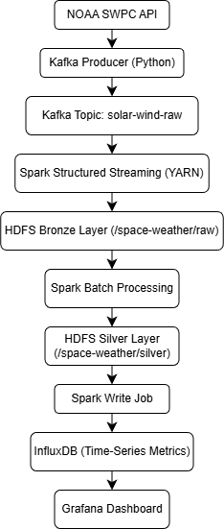
SYSTEM ARCHITECTURE
The system follows a streaming-first architecture with a clear separation of ingestion, processing, storage, and visualization layers.

Slide 6
DISTRIBUTED CLUSTER SETUP
I used a 2-node distributed cluster to run my space-weather data pipeline. The master node runs all main services (HDFS, Spark, Kafka, Zookeeper, InfluxDB, Grafana),and the worker node runs compute and storage services (DataNode + Spark Worker).
Sr.No | IP Address | NODE ROLE | SERVICES RUNNING
1. | 10.0.0.97 | MASTER | HDFS NameNode, SecondaryNameNode, YARN ResourceManager, Spark Master, Kafka Broker, Zookeeper, InfluxDB, Grafana
2. | 10.0.0.95 | WORKER1 | HDFS DataNode, YARN NodeManager, Spark Worker

Slide 7
Component Configuration & Service Mapping
Component | Role | Host / IP : Port | Notes
HDFS NameNode | Master | 10.0.0.97 : 9870 | Manages HDFS metadata
HDFS DataNode | Worker | 10.0.0.95 : 9864 | Stores HDFS blocks
YARN ResourceManager | Master | 10.0.0.97 : 8088 | Cluster resource management
YARN NodeManager | Worker | 10.0.0.95 | Executes containers
Spark Master / Driver | Master | 10.0.0.97 : 7077 | Spark scheduling
Spark Executor | Worker | 10.0.0.95 | Executes Spark tasks
Kafka Broker | Messaging | 10.0.0.97 : 9092 | solar-wind-raw topic
InfluxDB | TSDB | 10.0.0.97 : 8086 | Time-series storage
Grafana | Dashboard | 10.0.0.97 : 3000 | Visualization

Slide 8
MASTER AND WORKER NODE RUNNING
The master node runs all coordination services including HDFS NameNode, YARN ResourceManager, Spark Master, Kafka Broker, and Zookeeper.
The worker node runs distributed compute and storage services including DataNode, NodeManager, and Spark Worker.

Slide 9
DATA INGESTION WITH KAFKA
A Python-based Kafka producer continuously fetches live space weather data from the NOAA API and publishes JSON messages to the Kafka topic solar-wind-raw. Kafka ensures reliable, ordered, and fault-tolerant ingestion.

Slide 10
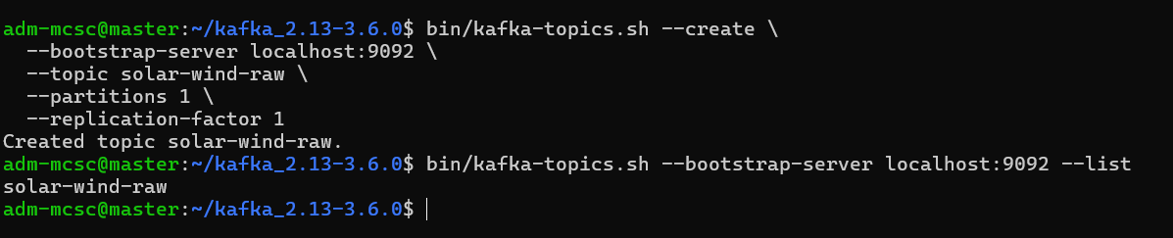
KAFKA TOPIC CREATION
Kafka is used as the streaming platform to ingest real-time space weather data.
The Kafka topic solar-wind-raw was created successfully and verified.

Slide 11
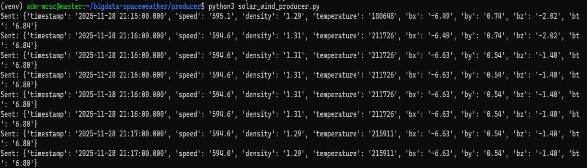
KAFKA PRODUCER RUNNING
A Python Kafka producer continuously fetches live space weather data from NOAA and sends JSON messages to Kafka.

Slide 12
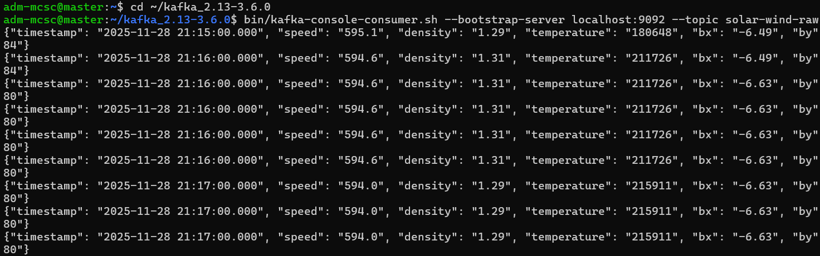
KAFKA CONSUMER VERIFICATION
Kafka consumer confirms that data is successfully received from the topic.

Slide 13
DATA PROCESSING WITH APACHE SPARK
Bronze Layer (Streaming)
Spark Structured Streaming reads data from Kafka and writes raw events to HDFS at /space-weather/raw. Checkpoints stored in /space-weather/checkpoints ensure fault tolerance and exactly-once processing.
Silver Layer (Batch Processing)
Spark batch jobs clean and structure the raw data by normalizing timestamps and enforcing schema. The cleaned data is written to /space-weather/silver in Parquet format.

Slide 14

SPARK STREAMING JOBS
Apache Spark is used to process the data in real time and batch mode.
The following Spark jobs were implemented:
kafka_to_hdfs.py
hdfs_to_silver.py
silver_to_influx.py

Slide 15
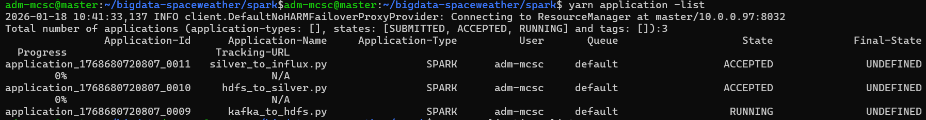
SPARK JOBS ON YARN
Spark applications are submitted and managed using YARN, confirming distributed execution.

Slide 16
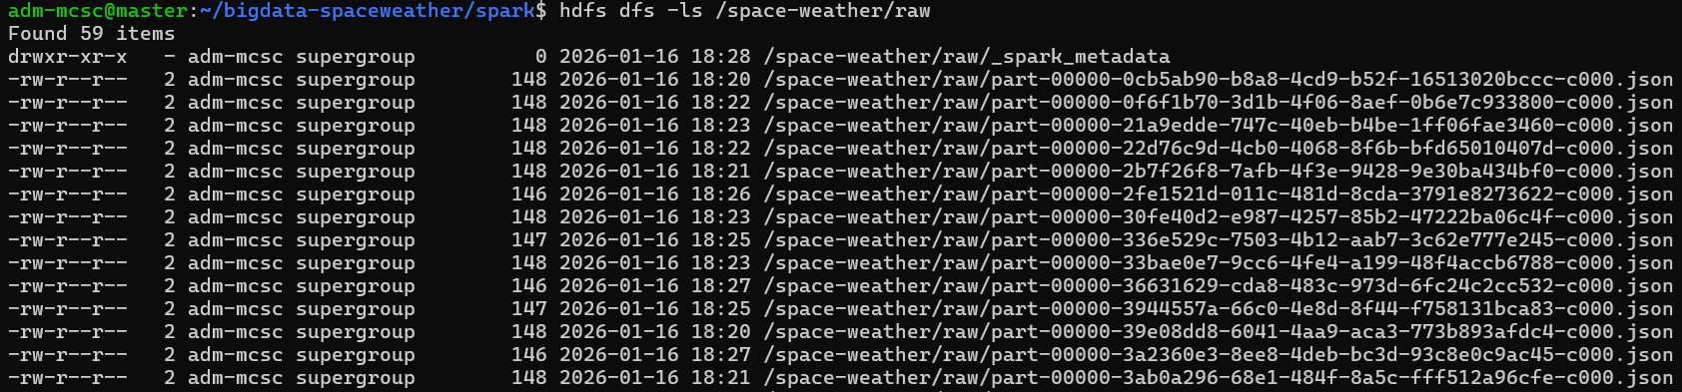
HDFS STORAGE
Raw streaming data is stored in HDFS for long-term storage and reprocessing.
HDFS ensures fault tolerance and distributed storage.

Slide 17
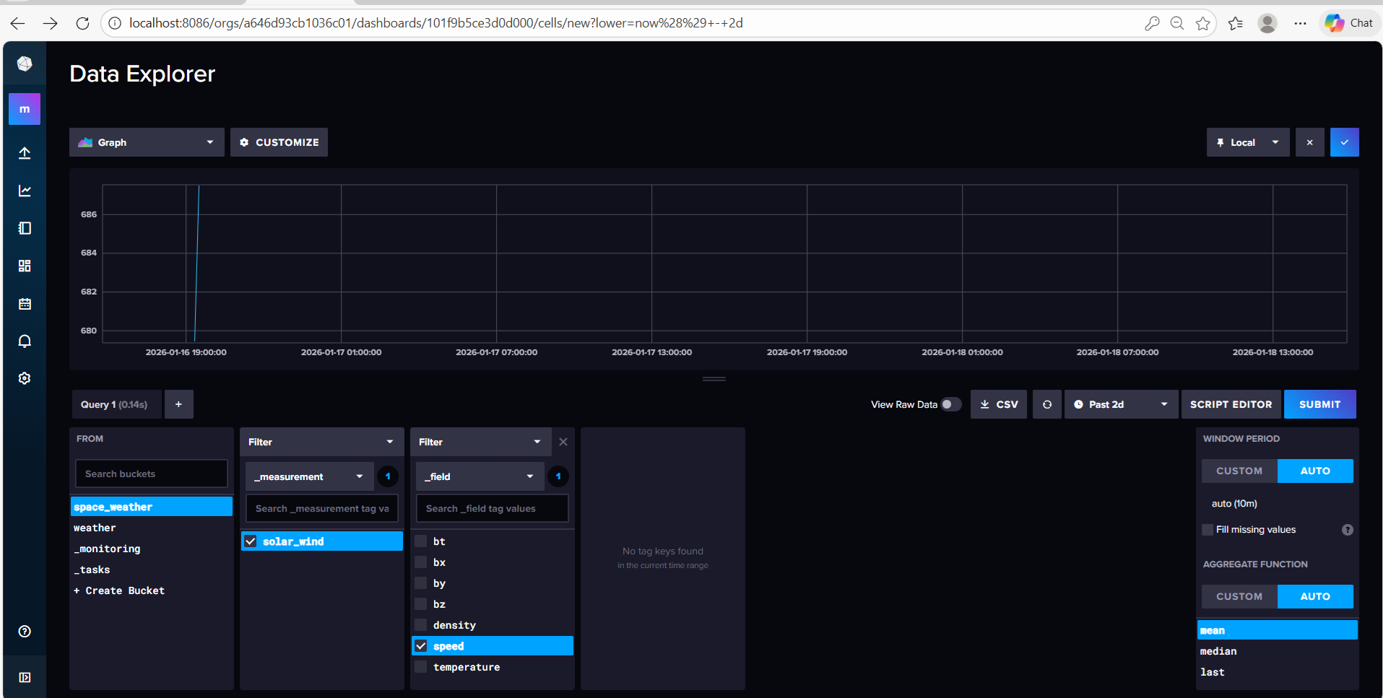
INFLUXDB
Processed space weather metrics are written to InfluxDB as time-series data.
Stored fields include:
speed
density
temperature
bx, by, bz, bt

Slide 18
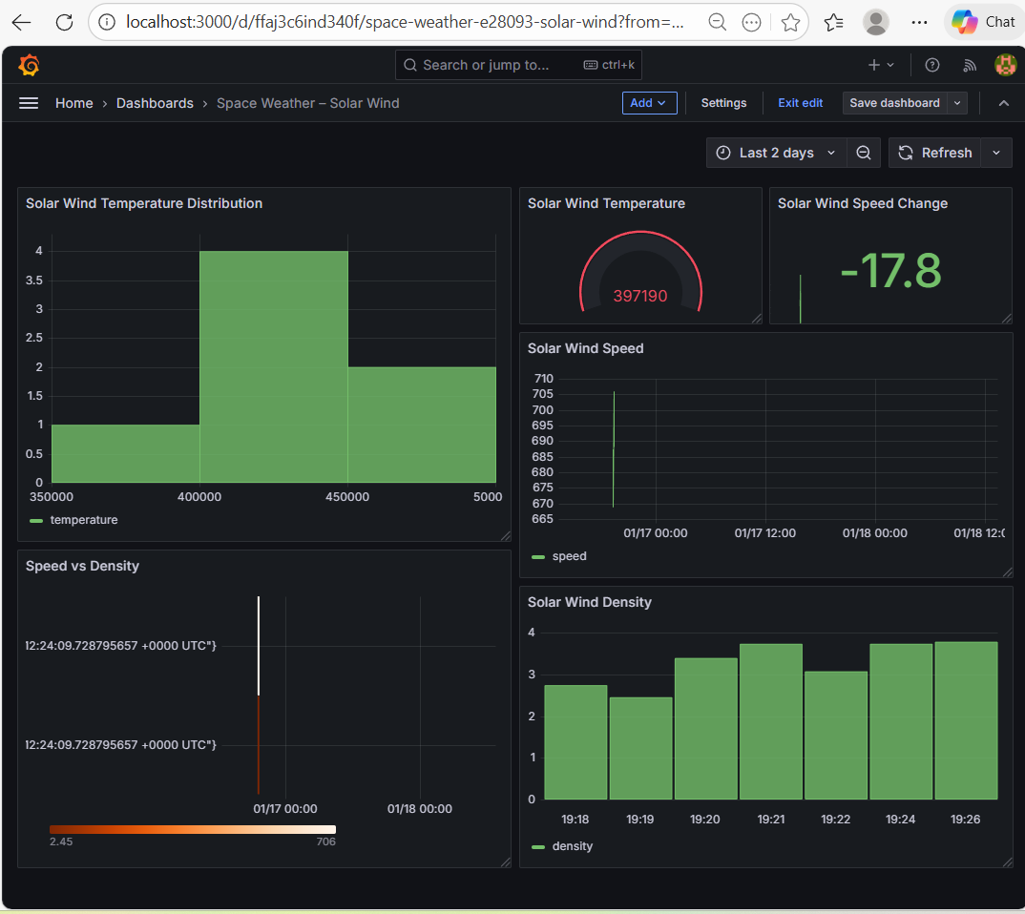
GRAFANA DASHBOARD
Grafana is used to visualize real-time space weather metrics.
The dashboard shows:
Solar wind speed
Density
Temperature
Speed vs Density

Slide 19
MEDALLION ARCHITECTURE
The project follows a practical medallion architecture:
Bronze: Raw streaming data in HDFS
Silver: Cleaned, structured data in HDFS
Gold: Time-series analytical metrics stored in InfluxDB and visualized in Grafana
This approach separates raw data from analytics-ready metrics.

Slide 20
CONCLUSION
This project demonstrates the successful implementation of an end-to-end, distributed real-time data pipeline for space weather analytics using Kafka, Spark, HDFS, InfluxDB, and Grafana.
Live data from the NOAA Space Weather Prediction Center was reliably ingested, processed, and stored using a scalable and fault-tolerant architecture.
The use of a medallion architecture ensured proper separation between raw and cleaned data, improving data quality and reusability. Real-time dashboards built with Grafana enabled continuous monitoring of key solar wind metrics, fulfilling the academic objectives and showcasing practical big data engineering skills.

